Slide 1
Complex Calculator
By:
Tisi Andrea
Salzano Simone
Montervino Dario
Spremulli Michele

Slide 2

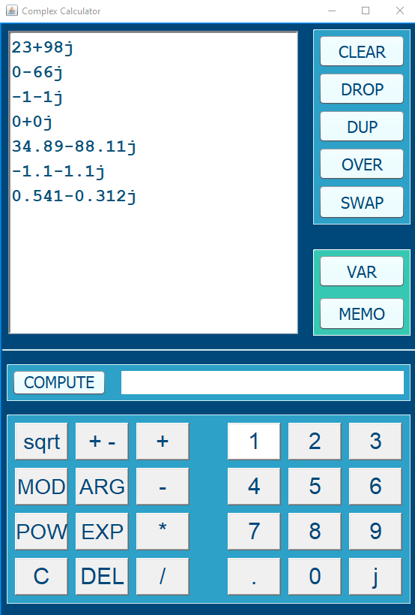
The core of our calculator

Slide 3
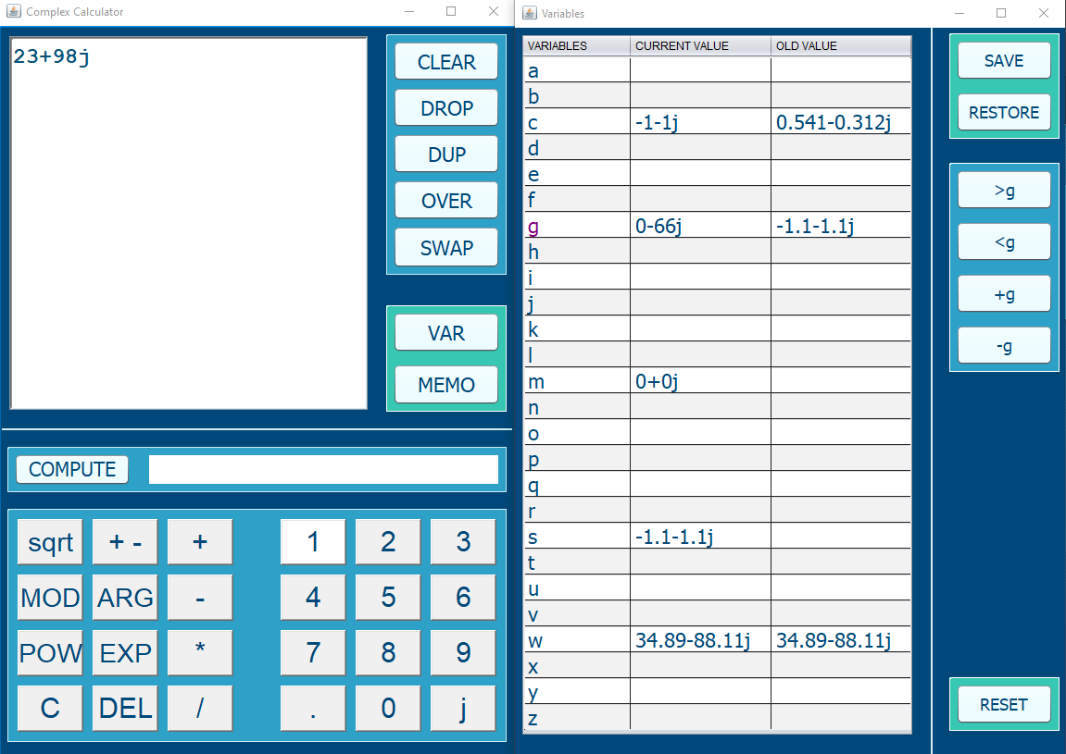
AUXILIARY VARIABLES
Save and restore the states of your 26 variables!
Adaptive buttons
Get a glimpse of the current variables values and their last previous saved state as well

Slide 4
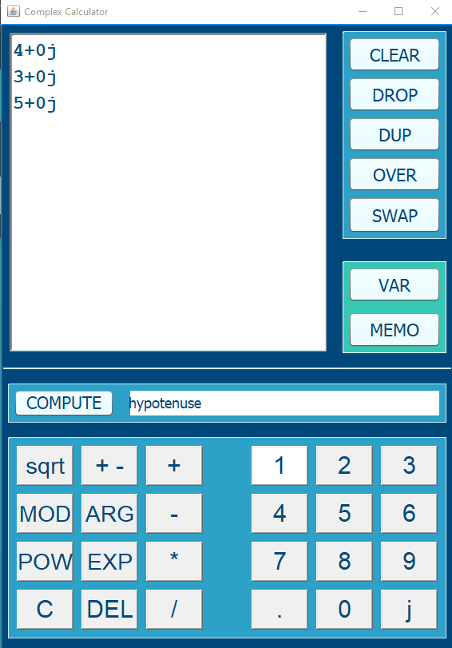
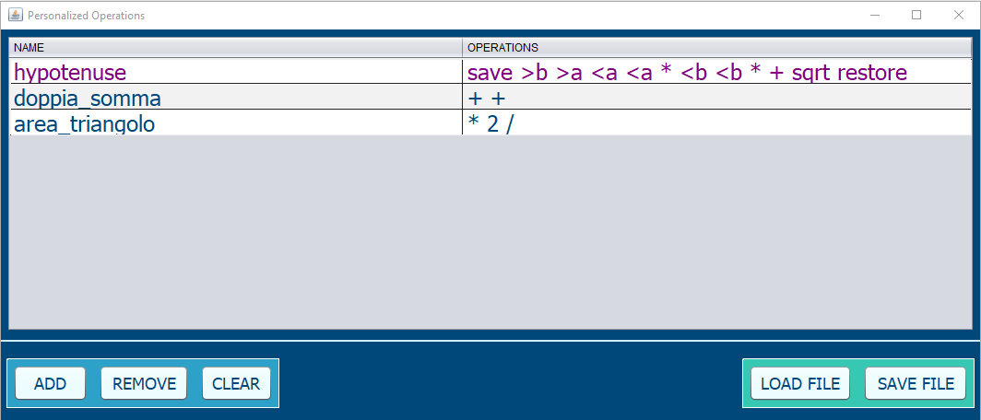
PERSONALIZED OPERATIONS
Save your personalized operations and run them whenever you want!!

Slide 5
SOFTWARE EVOLUTION

Slide 6
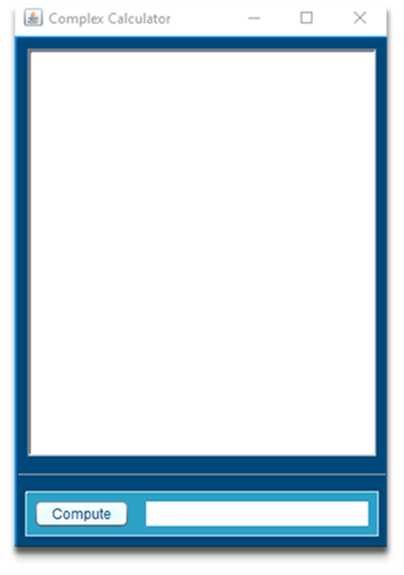
SW EVOLUTION: FIRST SPRINT
FUNDAMENTAL OPERATIONS
GUI: RAW

Slide 7
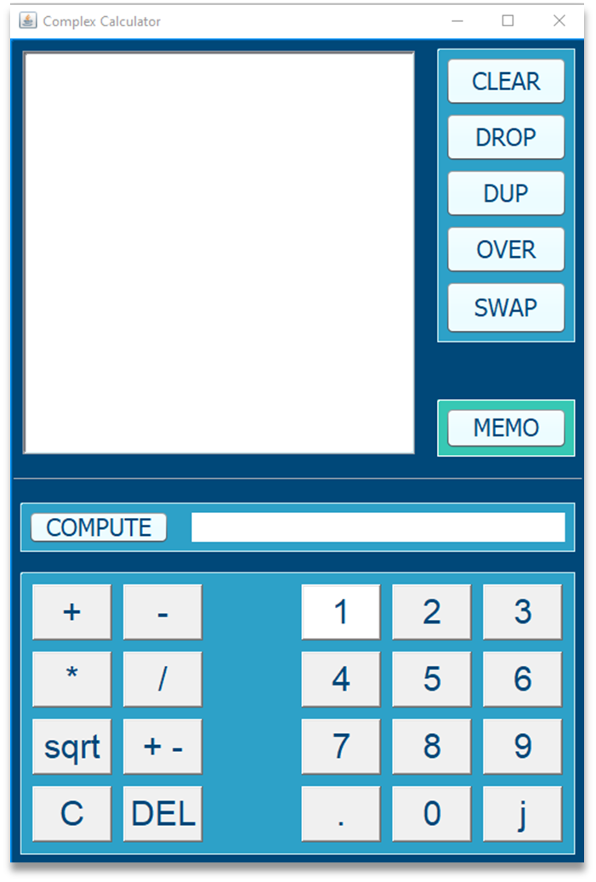
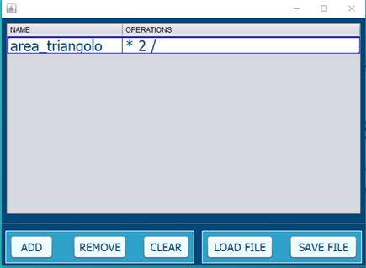
SW EVOLUTION: SECOND SPRINT
FUNDAMENTAL OPERATIONS
GUI: ADVANCED
MEMORY MANIPULATION
PERSONALIZED OPERATIONS

Slide 8
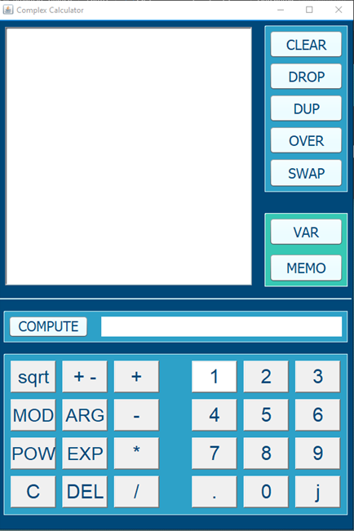
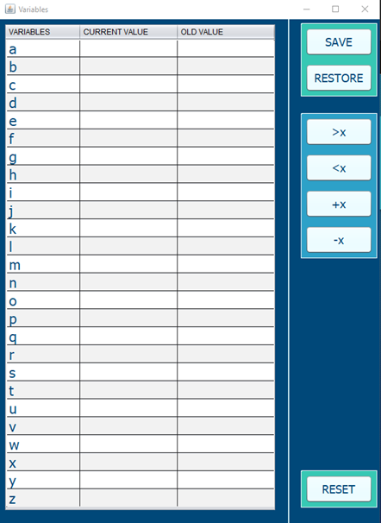
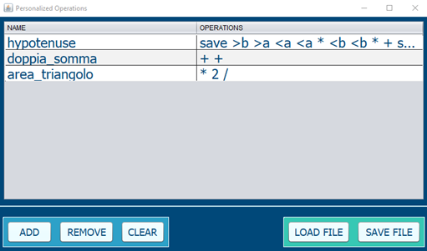
SW EVOLUTION: THIRD SPRINT
FUNDAMENTAL OPERATIONS
GUI: ADVANCED
MEMORY MANIPULATION
PERSONALIZED OPERATIONS
AUXILIARY VARIABLES
MANAGE VARIABLES’ STATE
SOME TRASCENDENTAL FUNC

Slide 9
DESIGN PATTERNS
SINGLETON
ITERATOR
OBSERVER

Slide 10
BURNDOWN CHART

Slide 11
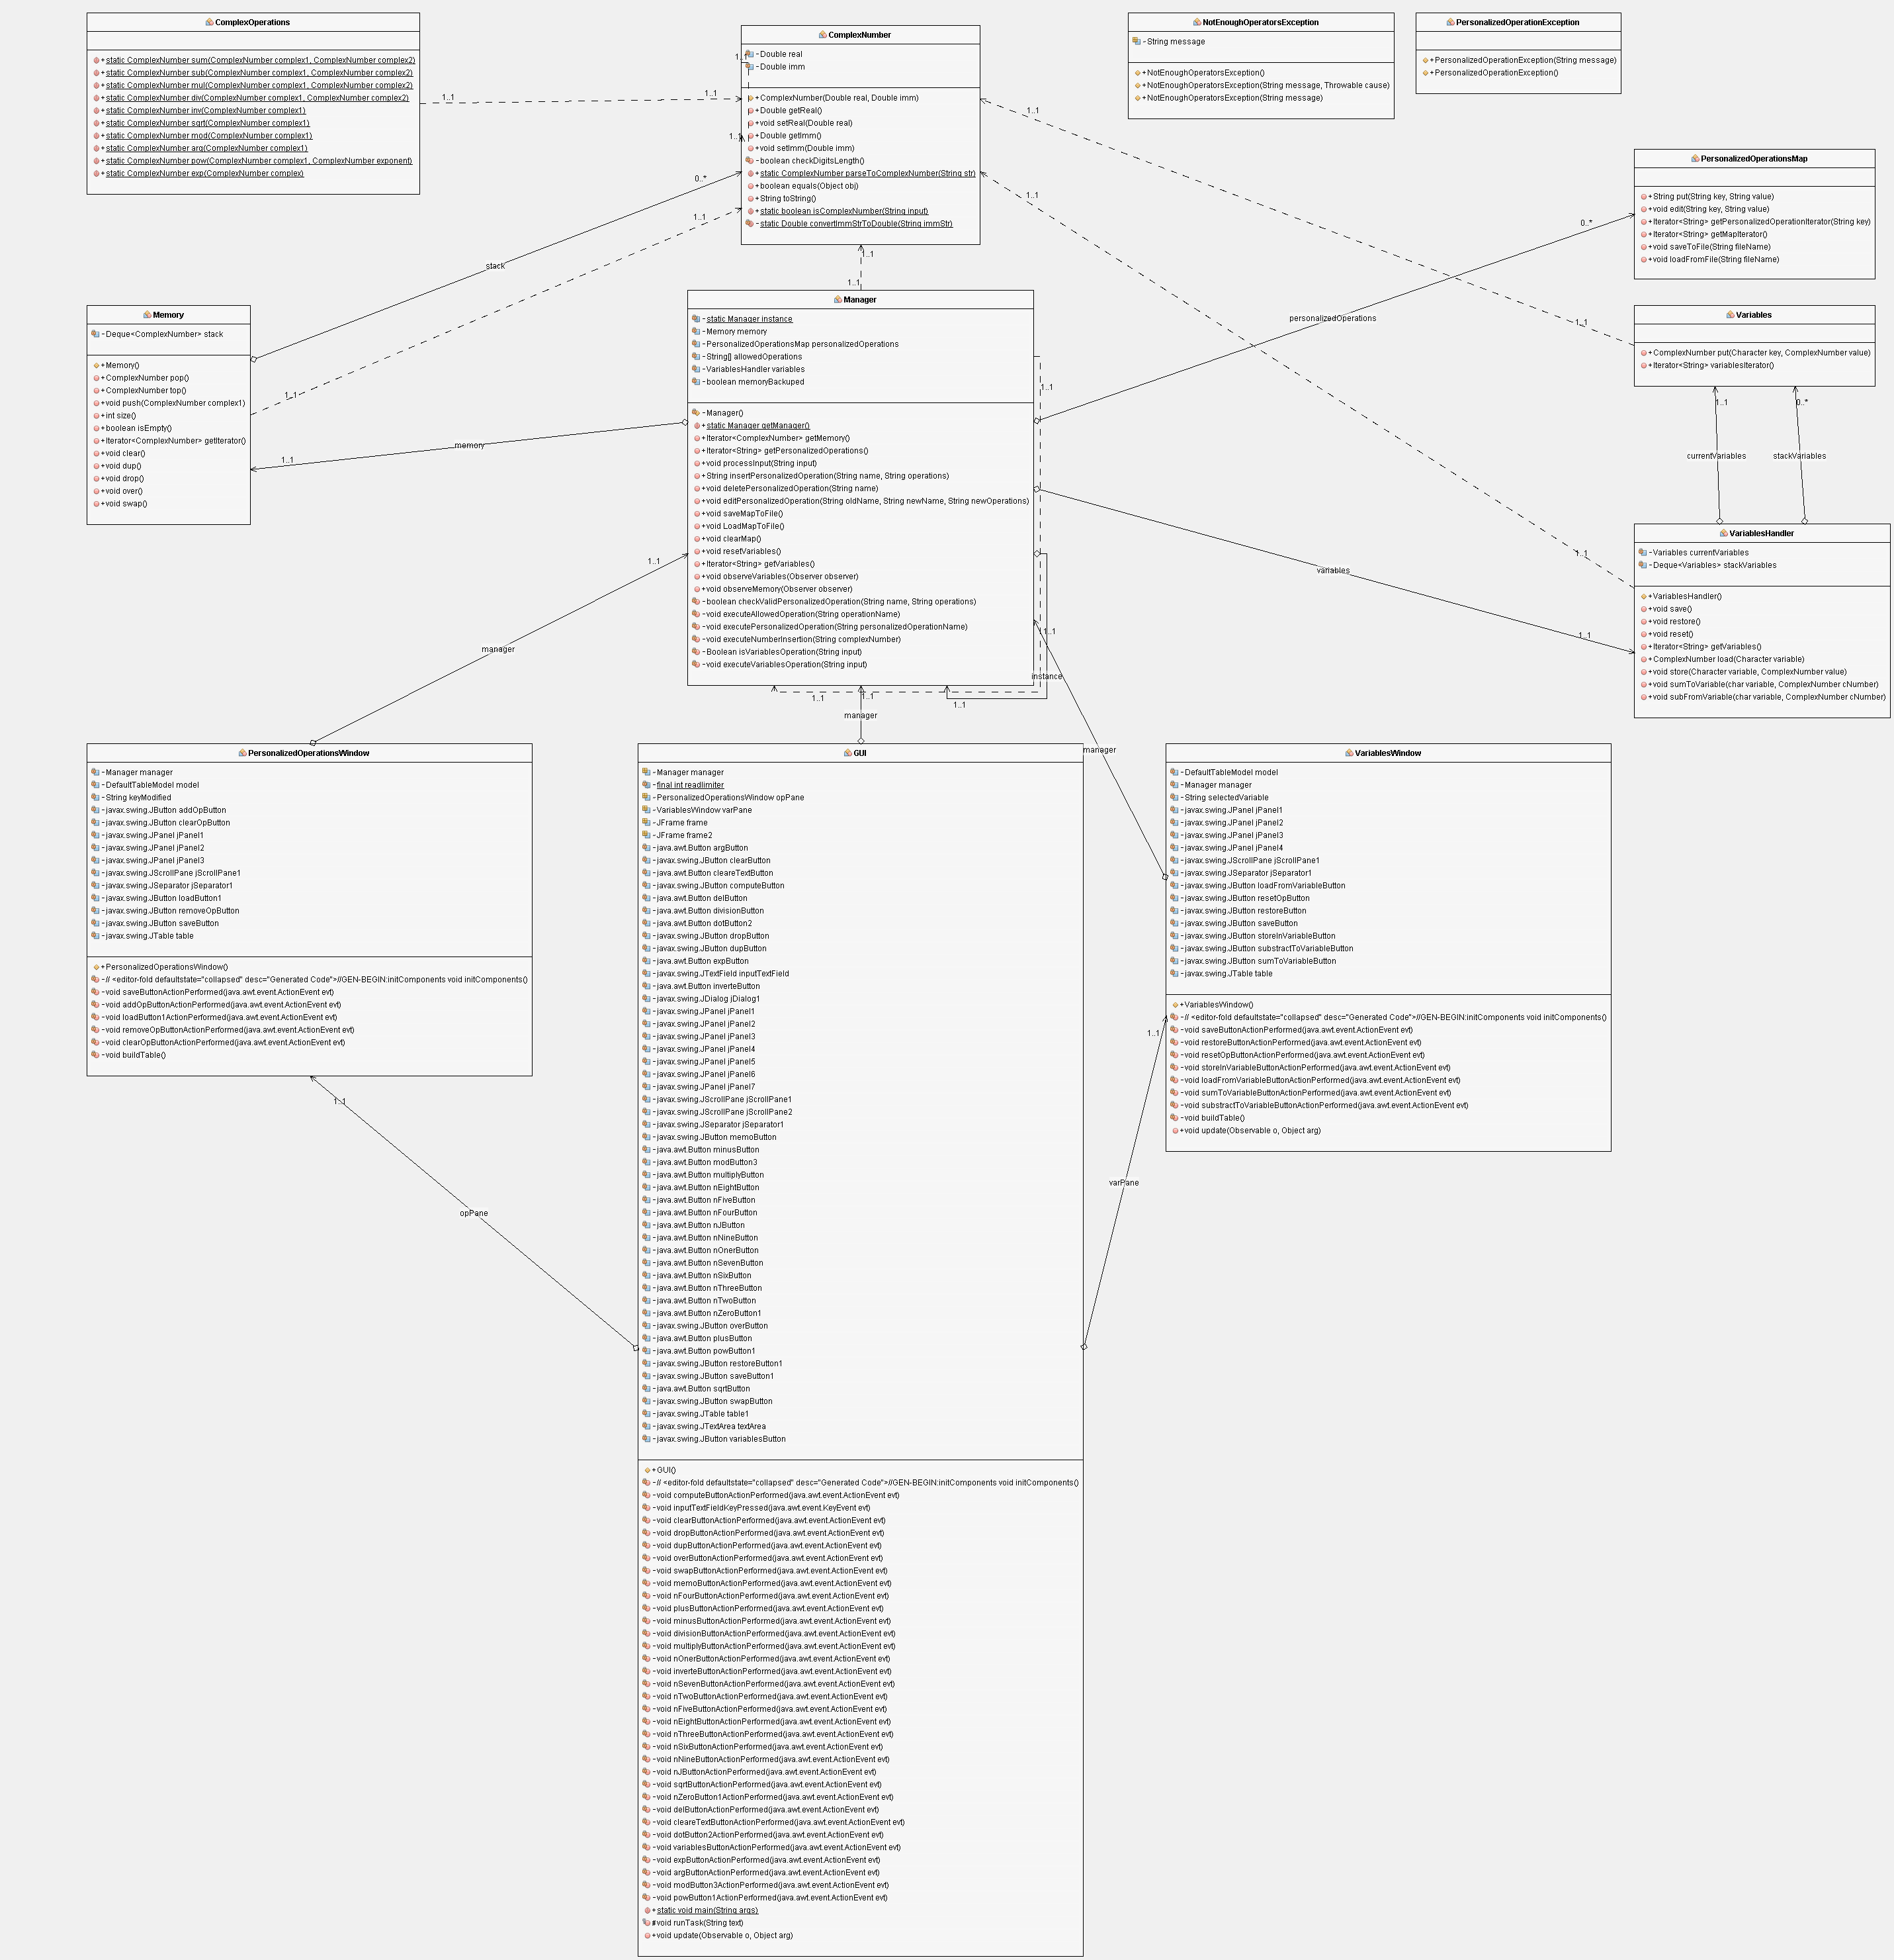
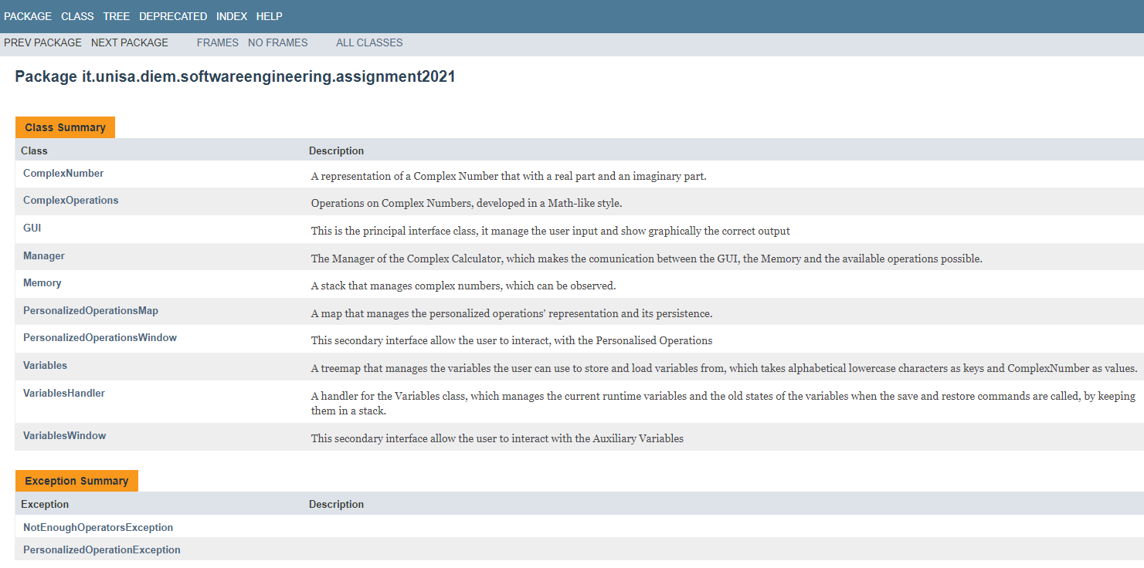
UML & DOCUMENTATION

Slide 12
LET’S TRY THIS

